Slide 1
Introduction to Data Science Machine Learning

Slide 2
Outline for this Evening
Three Basic Algorithms
kNN
Linear Regression
K-Means
Training Issues
Measuring model quality
Over-fitting
Cross-validation

Slide 3
Machine Learning
Supervised: We are given input samples (X) and output samples (y) of a function y = f(X). We would like to “learn” f, and evaluate it on new data. Types:
Classification: y is discrete (class labels).
Regression: y is continuous, e.g. linear regression.
Unsupervised: Given only samples X of the data, we compute a function f such that y = f(X) is “simpler”.
Clustering: y is discrete
Y is continuous: Matrix factorization, Kalman filtering, unsupervised neural networks.

Slide 4
Machine Learning
Supervised:
Is this image a cat, dog, car, house?
How would this user score that restaurant?
Is this email spam?
Is this blob a supernova?
Unsupervised
Cluster some hand-written digit data into 10 classes.
What are the top 20 topics in Twitter right now?
Find and cluster distinct accents of people at Berkeley.

Slide 5
Techniques
Supervised Learning:
kNN (k Nearest Neighbors)
Linear Regression
Naïve Bayes
Logistic Regression
Support Vector Machines
Random Forests
Unsupervised Learning:
Clustering
Factor analysis
Topic Models

Slide 6
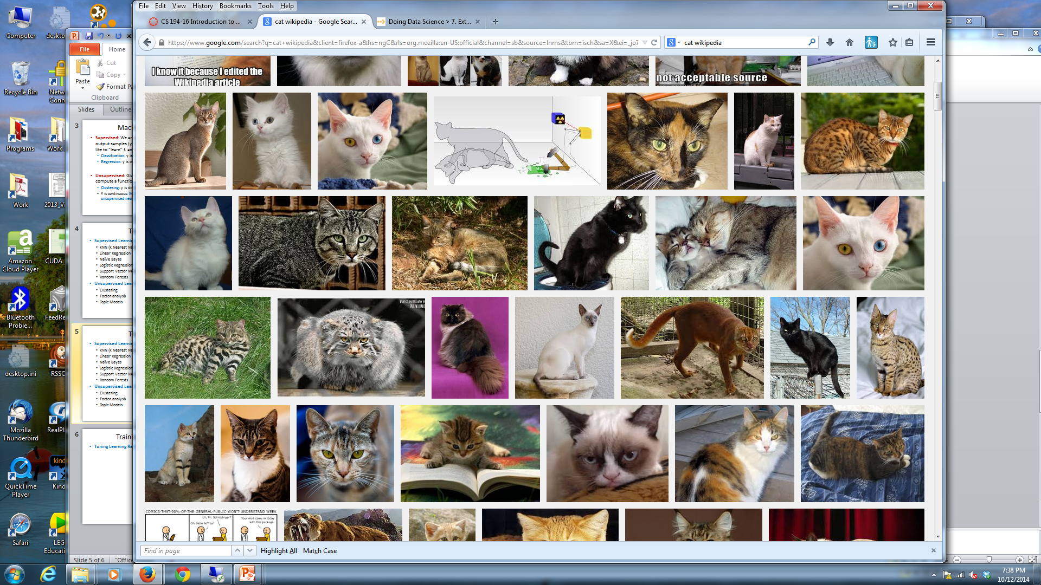
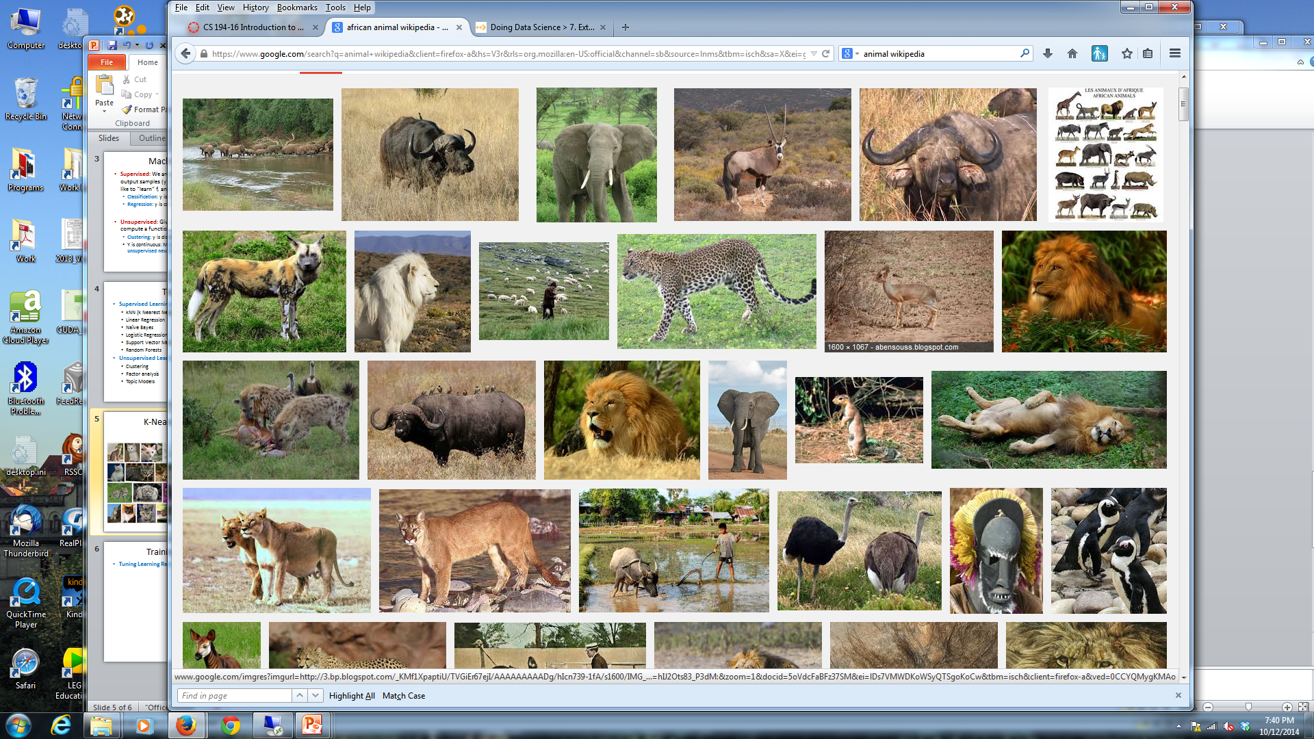
k-Nearest Neighbors
Given a query item: Find k closest matches in a labeled dataset ↓

Slide 7
k-Nearest Neighbors
Given a query item: Return the most Find k closest matches Frequent label

Slide 8
k-Nearest Neighbors
k = 3 votes for “cat”

Slide 9
k-Nearest Neighbors
2 votes for cat,
1 each for Buffalo, Cat wins…
Deer, Lion

Slide 10
k-NN issues
The Data is the Model
No training needed.
Accuracy generally improves with more data.
Matching is simple and fast (and single pass).
Usually need data in memory, but can be run off disk.
Minimal Configuration:
Only parameter is k (number of neighbors)
Two other choices are important:
Weighting of neighbors (e.g. inverse distance)
Similarity metric

Slide 11
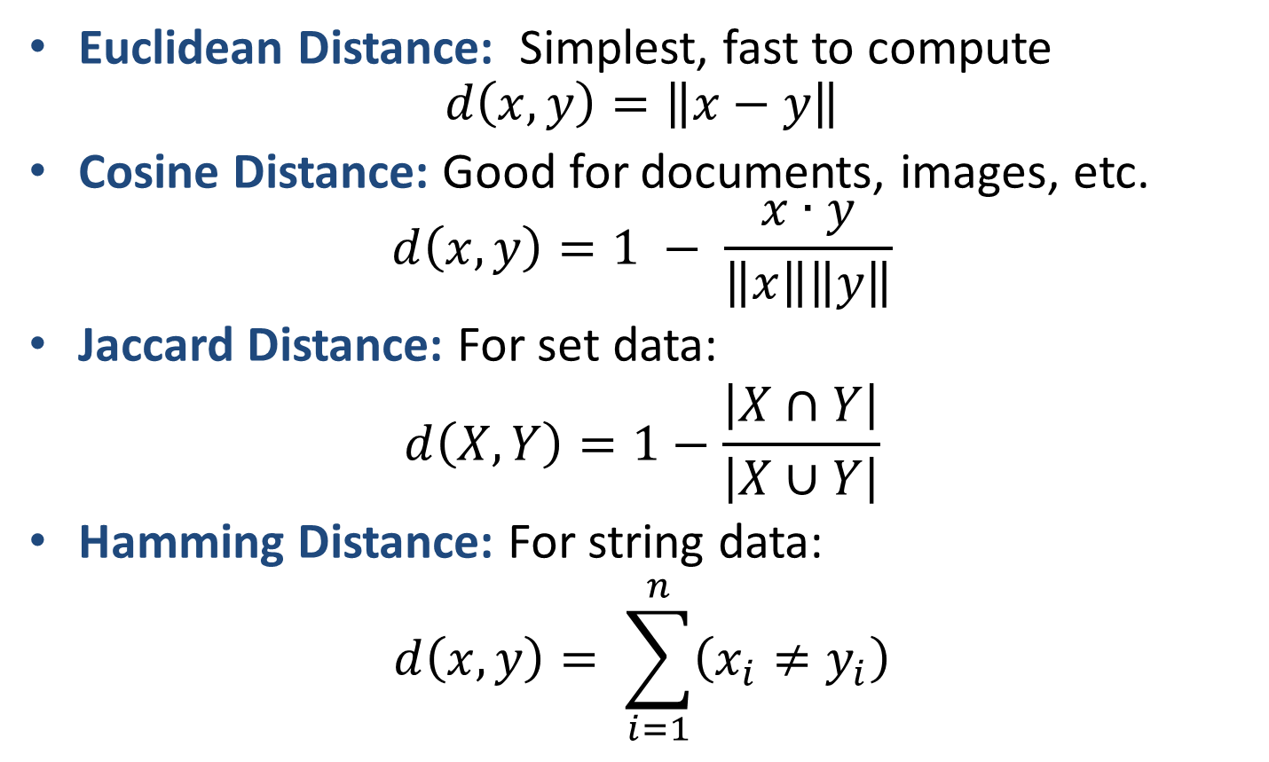
K-NN metrics
Euclidean Distance: Simplest, fast to compute $d\left(x,y\right)=\left\|x−y\right\|$
Cosine Distance: Good for documents, images, etc. $d\left(x,y\right)=1 − \frac{x∙y}{\left\|x\right\|\left\|y\right\|}$
Jaccard Distance: For set data:
$$d\left(X,Y\right)=1−\frac{\left|X∩Y\right|}{\left|X∪Y\right|}$$
Hamming Distance: For string data:
$$d\left(x,y\right)= \sum_{i=1}^{n}{\left(x_{i}≠y_{i}\right)}$$

Slide 12
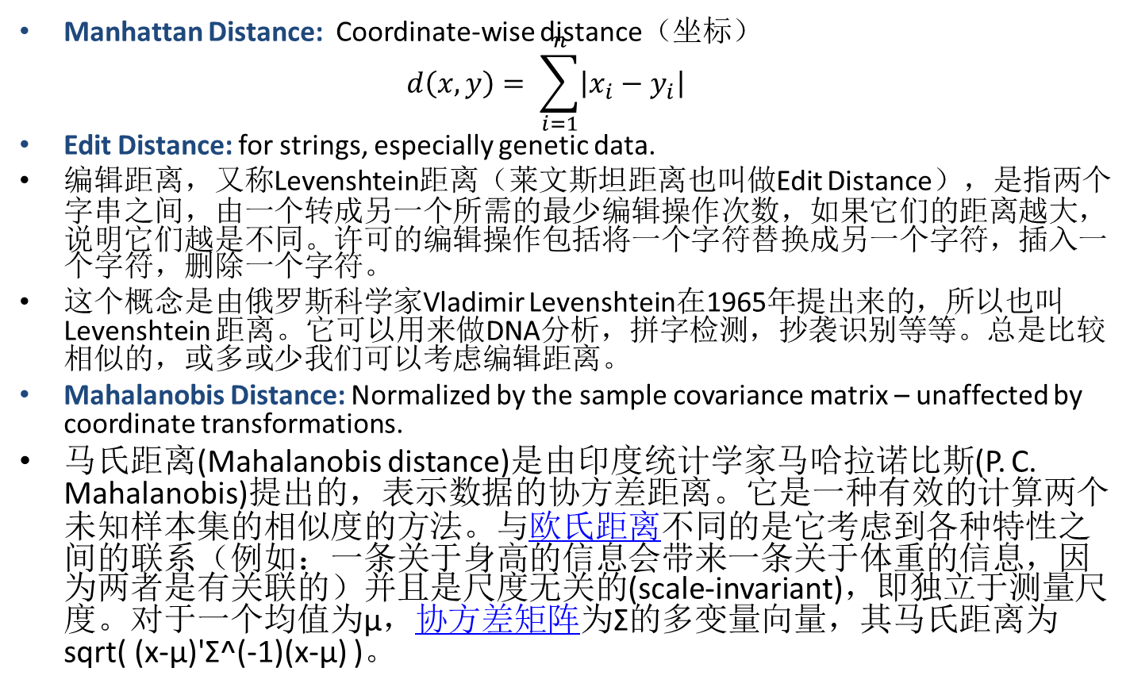
K-NN metrics
Manhattan Distance: Coordinate-wise distance（坐标） $d\left(x,y\right)= \sum_{i=1}^{n}{\left|x_{i}−y_{i}\right|}$
Edit Distance: for strings, especially genetic data.
编辑距离，又称Levenshtein距离（莱文斯坦距离也叫做Edit Distance），是指两个字串之间，由一个转成另一个所需的最少编辑操作次数，如果它们的距离越大，说明它们越是不同。许可的编辑操作包括将一个字符替换成另一个字符，插入一个字符，删除一个字符。
这个概念是由俄罗斯科学家Vladimir Levenshtein在1965年提出来的，所以也叫 Levenshtein 距离。它可以用来做DNA分析，拼字检测，抄袭识别等等。总是比较相似的，或多或少我们可以考虑编辑距离。
Mahalanobis Distance: Normalized by the sample covariance matrix – unaffected by coordinate transformations.
马氏距离(Mahalanobis distance)是由印度统计学家马哈拉诺比斯(P. C. Mahalanobis)提出的，表示数据的协方差距离。它是一种有效的计算两个未知样本集的相似度的方法。与欧氏距离不同的是它考虑到各种特性之间的联系（例如：一条关于身高的信息会带来一条关于体重的信息，因为两者是有关联的）并且是尺度无关的(scale-invariant)，即独立于测量尺度。对于一个均值为μ，协方差矩阵为Σ的多变量向量，其马氏距离为sqrt( (x-μ)'Σ^(-1)(x-μ) )。

Slide 13
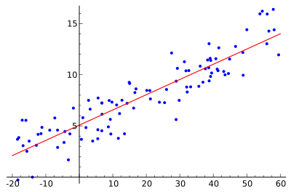
Linear Regression
We want to find the best line (linear function y=f(X)) to explain the data.
y
X

Slide 14
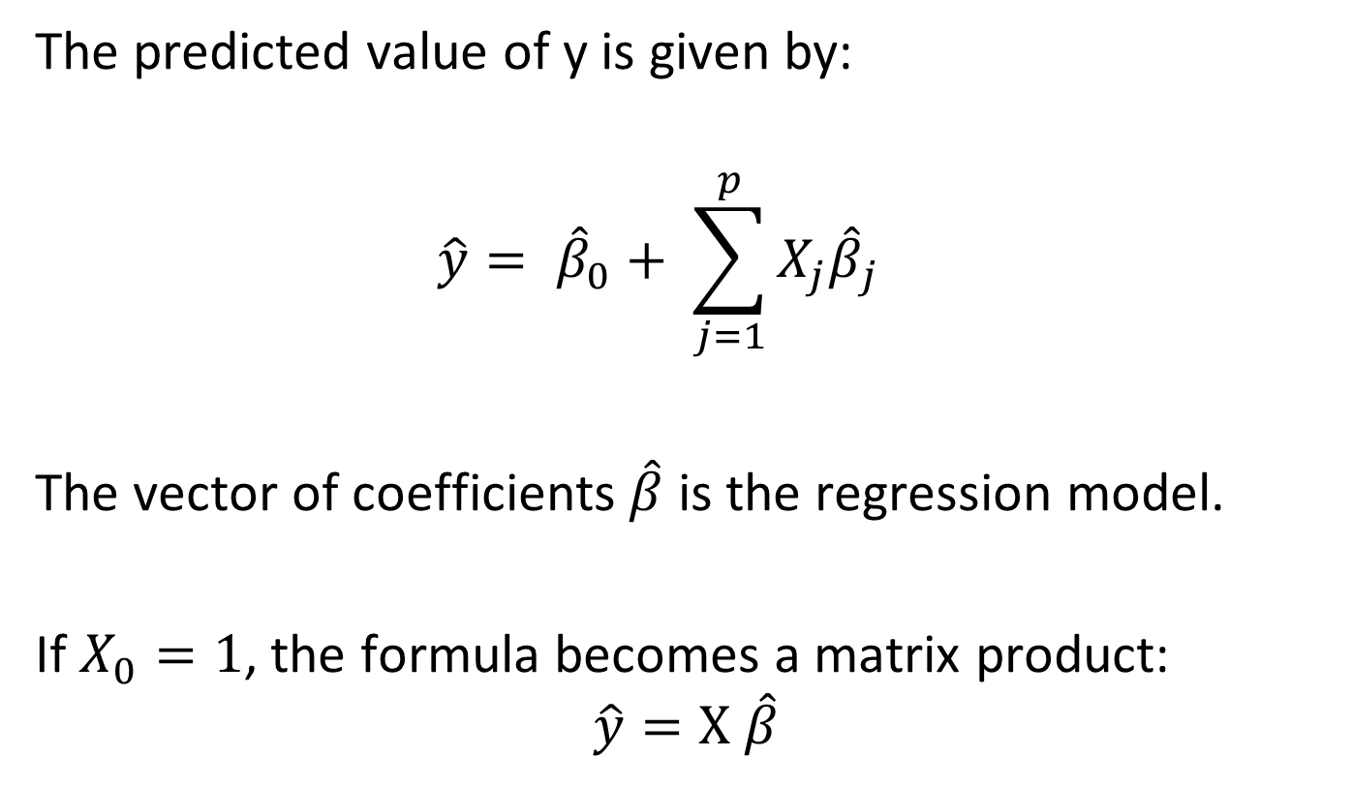
Linear Regression
The predicted value of y is given by:
$$\hat{y}= {\hat{β}}_{0}+ \sum_{j=1}^{p}{X_{j}{\hat{β}}_{j}}$$
The vector of coefficients $\hat{β}$ is the regression model.
If $X_{0}=1$, the formula becomes a matrix product:
$$\hat{y}=X \hat{β}$$

Slide 15
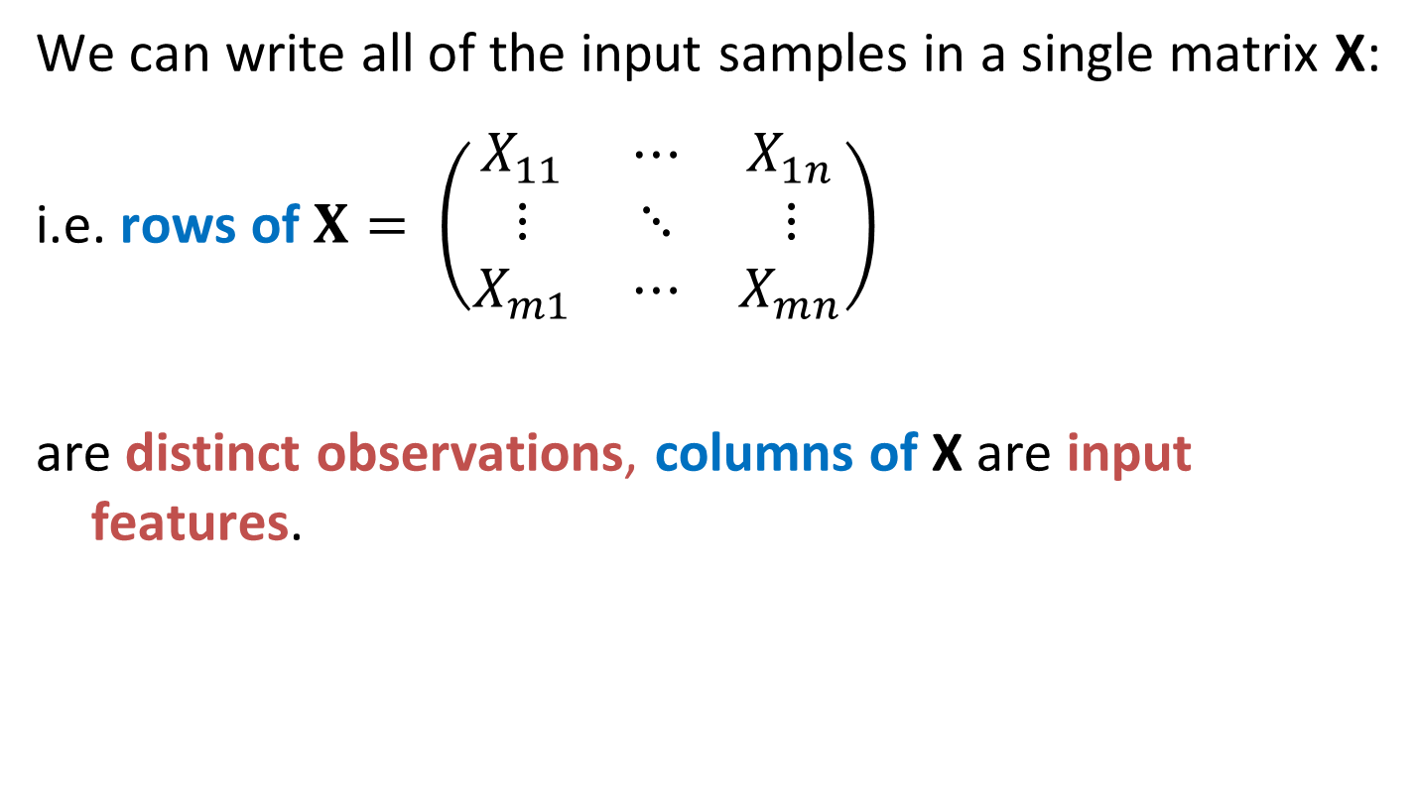
Linear Regression
We can write all of the input samples in a single matrix X:
i.e. rows of $X= \left(\begin{matrix}X_{11} & ⋯ & X_{1n} \\ ⋮ & ⋱ & ⋮ \\ X_{m1} & ⋯ & X_{mn}\end{matrix}\right)$
are distinct observations, columns of X are input features.

Slide 16
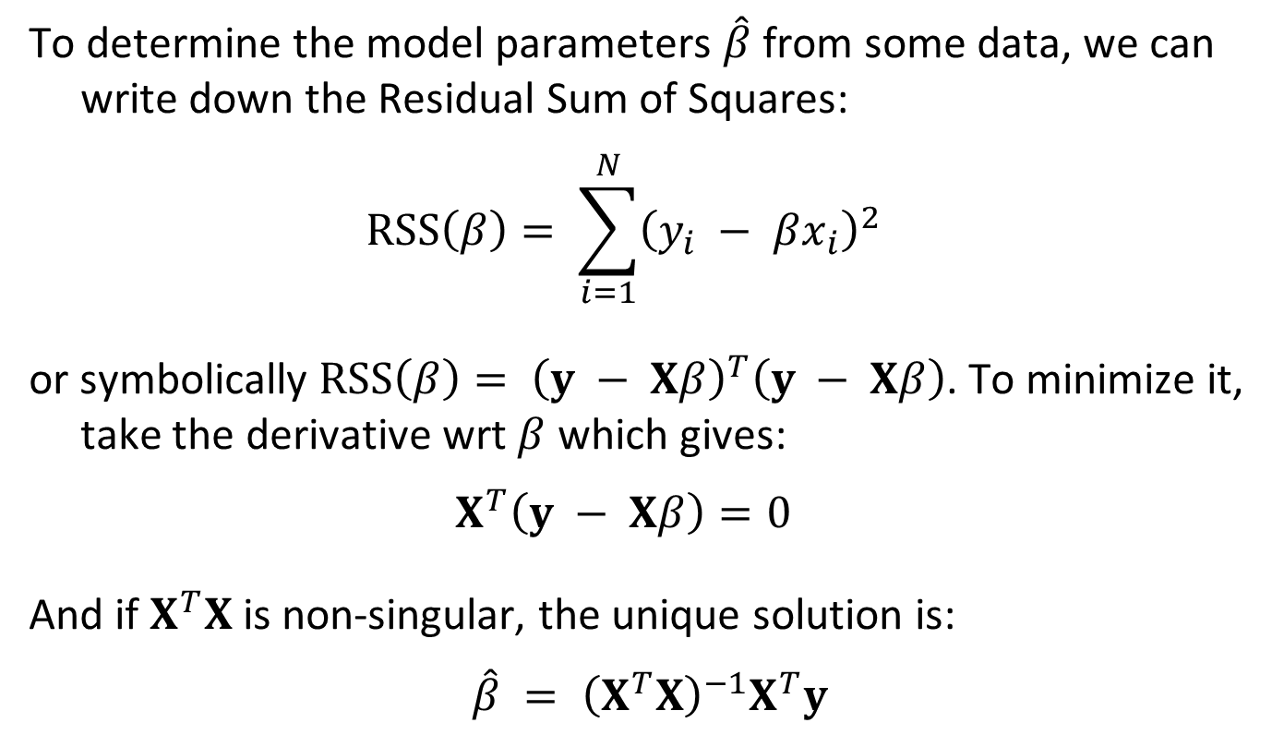
Residual Sum-of-Squares （残差平方和）
To determine the model parameters $\hat{β}$ from some data, we can write down the Residual Sum of Squares:
$$RSS\left(β\right)= \sum_{i=1}^{N}{{\left(y_{i} − βx_{i}\right)}^{2}}$$
or symbolically $RSS\left(β\right)= {\left(y − Xβ\right)}^{T}\left(y − Xβ\right)$. To minimize it, take the derivative wrt $β$ which gives:
$$X^{T}\left(y − Xβ\right)=0$$
And if $X^{T}X$ is non-singular, the unique solution is:
$$\hat{β} = {\left(X^{T}X\right)}^{−1}X^{T}y$$

Slide 17
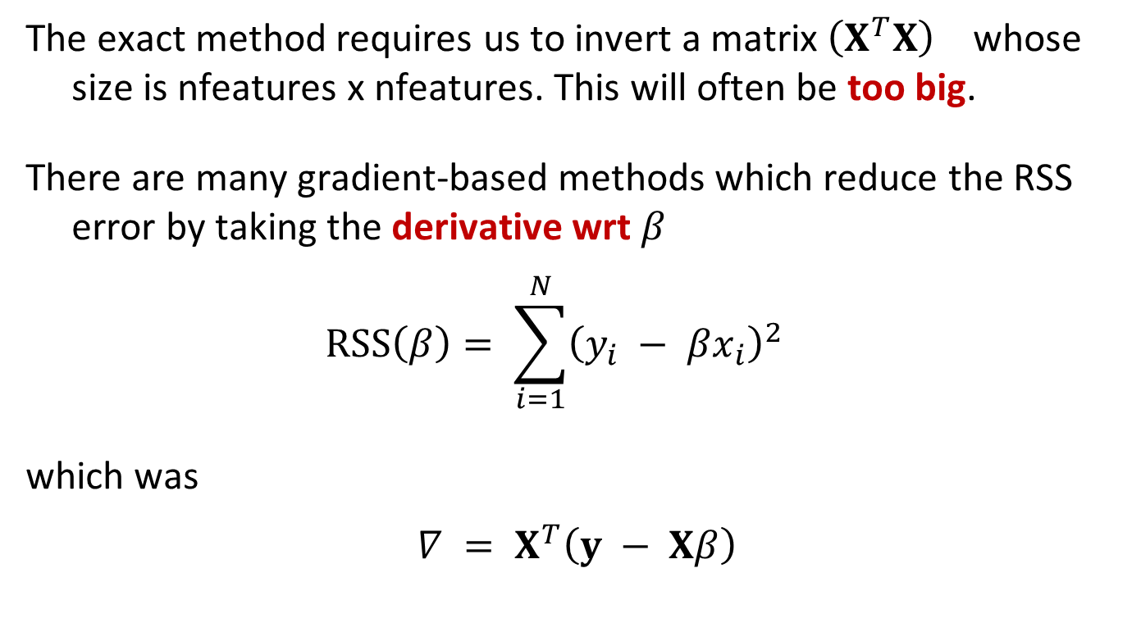
Iterative Regression Solutions
The exact method requires us to invert a matrix ${\left(X^{T}X\right)}^{}$ whose size is nfeatures x nfeatures. This will often be too big.
There are many gradient-based methods which reduce the RSS error by taking the derivative wrt $β$
$$RSS\left(β\right)= \sum_{i=1}^{N}{{\left(y_{i} − βx_{i}\right)}^{2}}$$
which was
$$∇ = X^{T}\left(y − Xβ\right)$$

Slide 18
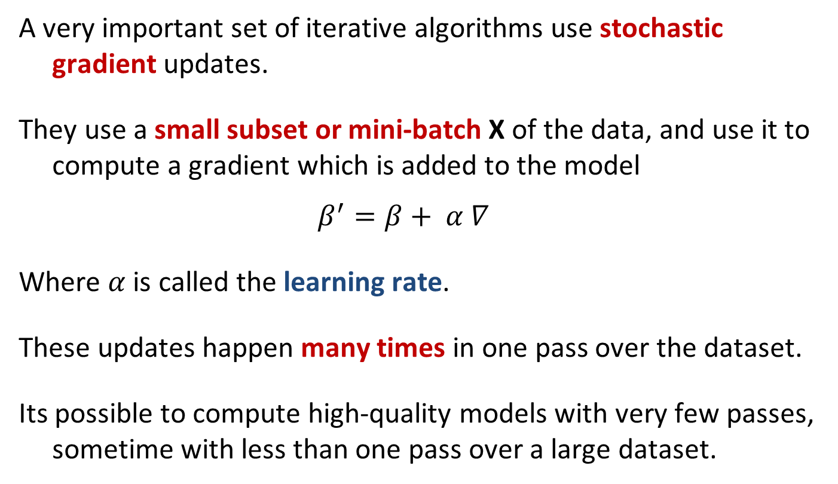
Stochastic Gradient
A very important set of iterative algorithms use stochastic gradient updates.
They use a small subset or mini-batch X of the data, and use it to compute a gradient which is added to the model
$$β^{′}=β+ α ∇$$
Where $α$is called the learning rate.
These updates happen many times in one pass over the dataset.
Its possible to compute high-quality models with very few passes, sometime with less than one pass over a large dataset.

Slide 19
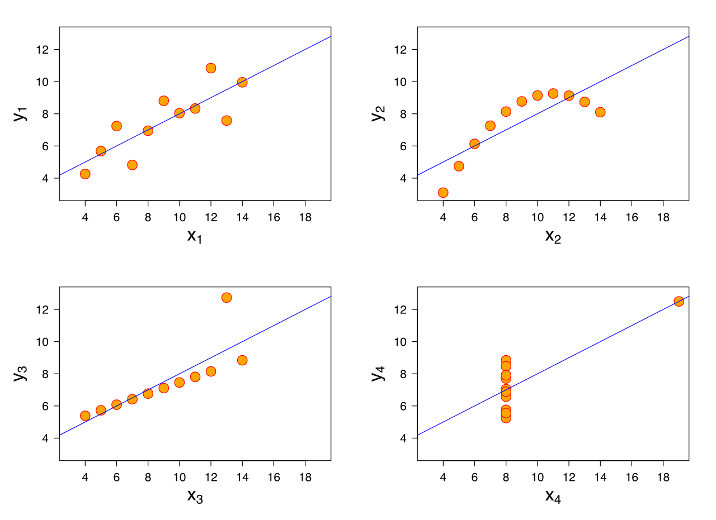
R²-values and P-values
We can always fit a linear model to any dataset, but how do we know if there is a real linear relationship?
Notes:
用系数R²的值判断模型的拟合效果，R²越大，模型的拟合效果越好
可用相关系数r的值判断两个变量的相关性，|r|越大，说明相关性越强

Slide 20
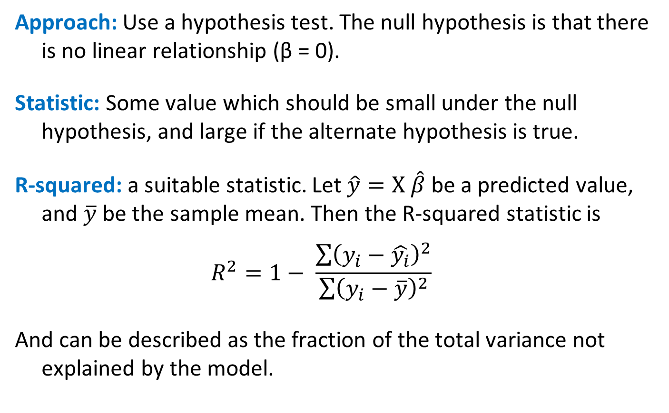
R²-values and P-values
Approach: Use a hypothesis test. The null hypothesis is that there is no linear relationship (β = 0).
Statistic: Some value which should be small under the null hypothesis, and large if the alternate hypothesis is true.
R-squared: a suitable statistic. Let $\hat{y}=X \hat{β}$ be a predicted value, and $\overline{y}$ be the sample mean. Then the R-squared statistic is
$$R^{2}=1− \frac{\sum{{\left(y_{i}−\hat{y_{i}}\right)}^{2}}}{\sum{{\left(y_{i}−\overline{y}\right)}^{2}}}$$
And can be described as the fraction of the total variance not explained by the model.

Slide 21
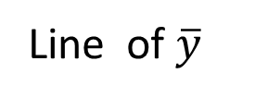
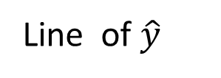
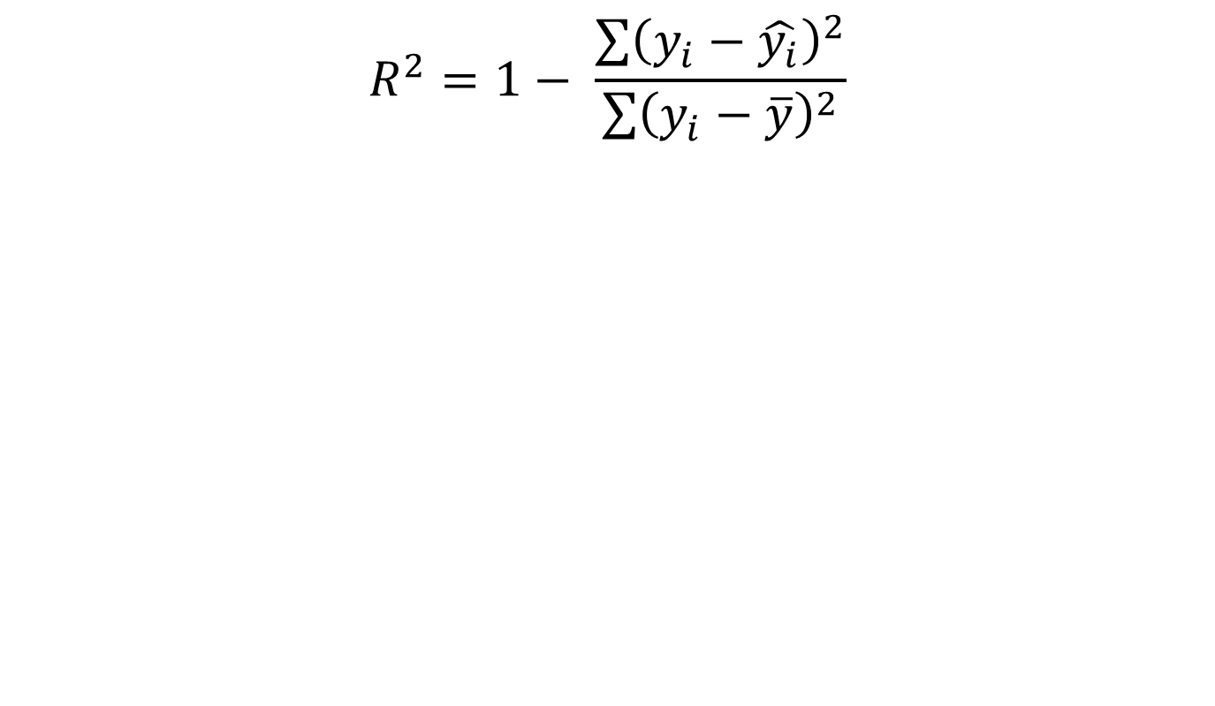
R-squared
Small if good fit
$$R^{2}=1− \frac{\sum{{\left(y_{i}−\hat{y_{i}}\right)}^{2}}}{\sum{{\left(y_{i}−\overline{y}\right)}^{2}}}$$
y
Line of $\hat{y}$
Line of $\overline{y}$
X
Notes:
What R-squared value would you expect under the null hypothesis ?

Slide 22
R²-values and P-values
Statistic: From R-squared we can derive another statistic (using degrees of freedom) that has a standard distribution called an F-distribution.
From the CDF for the F-distribution, we can derive a P-value for the data.
The P-value is, as usual, the probability of observing the data under the null hypothesis of no linear relationship.
If p is small, say less than 0.05, we conclude that there is a linear relationship.

Slide 23
Clustering – Why?
Clustering has one or more goals:
Segment a large set of cases into small subsets that can be treated similarly - segmentation
Generate a more compact description of a dataset - compression
Model an underlying process that generates the data as a mixture of different, localized processes – representation

Slide 24
Clustering – Why?
Examples:
Segment: image segmentation
Compression: Cluster-based kNN, e.g. handwritten digit recognition.
Underlying process: Accents of people at Berkeley (??) – because place of origin strongly influences the accent you have.

Slide 25
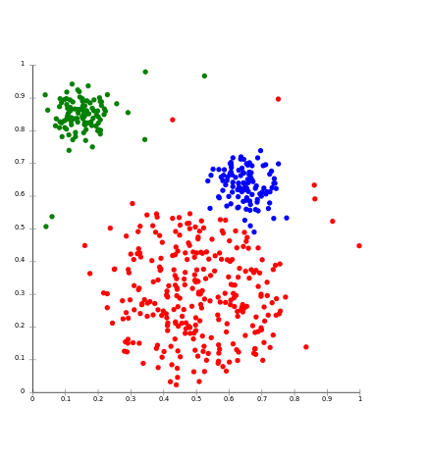
Stereotypical Clustering
Note: Points are samples plotted in feature space, e.g. 10,000-dimensional space for 100x100 images.
Notes:
老一套的聚类

Slide 26
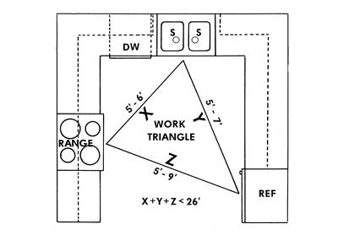
Model-based Clustering

Slide 27
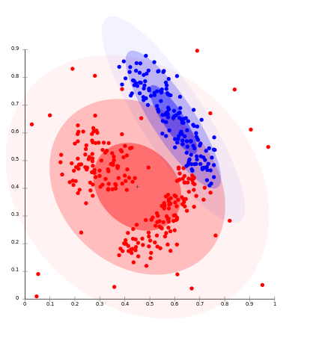
Model-based Clustering

Slide 28
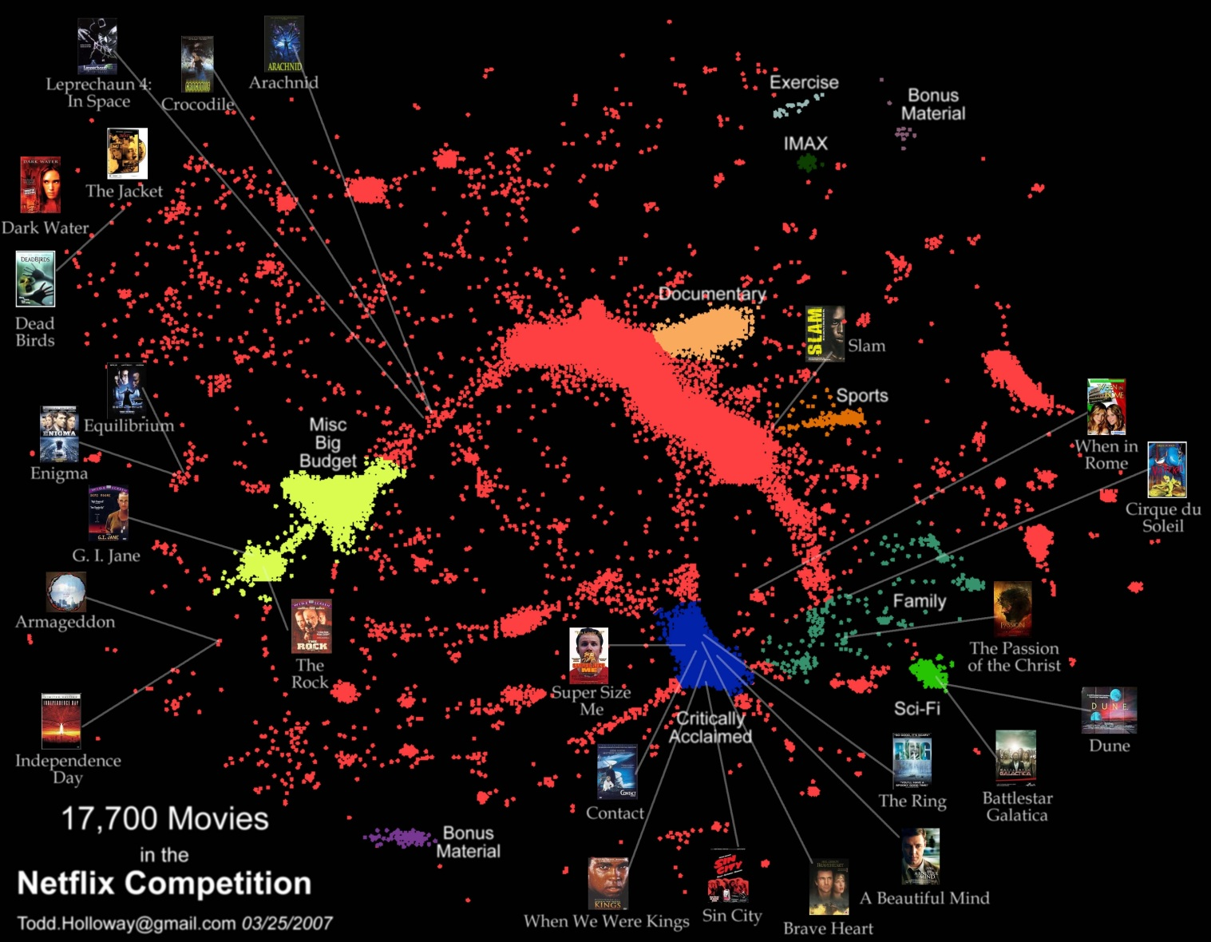
Netflix
More of a continuum than discrete clusters
Factor models, kNN do much better than discrete cluster models.
Notes:
Continuum连续的统一体

Slide 29
“Cluster Bias”
Upshot:
Clustering is used more than it should be, because people assume an underlying domain has discrete classes in it.
This is especially true for characteristics of people, e.g. Myers-Briggs personality types like “ENTP”.
In reality the underlying data is usually continuous.
Just as with Netflix, continuous models (dimension reduction, kNN) tend to do better.

Slide 30
Terminology
Hierarchical clustering: clusters form a hierarchy. Can be computed bottom-up or top-down.
Flat clustering: no inter-cluster structure.
Hard clustering: items assigned to a unique cluster.
Soft clustering: cluster membership is a real-valued function, distributed across several clusters.

Slide 31
K-means clustering
The standard k-means algorithm is based on Euclidean distance.
The cluster quality measure is an intra-cluster measure only, equivalent to the sum of item-to-centroid kernels.
A simple greedy algorithm locally optimizes this measure (usually called Lloyd’s algorithm):
Find the closest cluster center for each item, and assign it to that cluster.
Recompute the cluster centroid as the mean of items, for the newly-assigned items in the cluster.

Slide 32
K-means clustering
Cluster centers – can pick by sampling the input data.

Slide 33
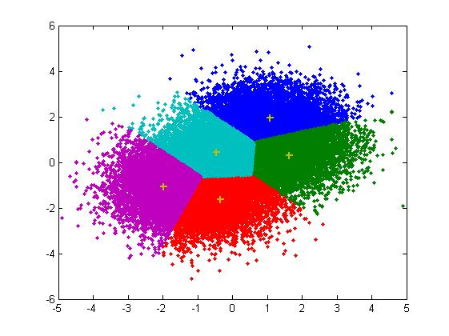
K-means clustering
Assign points to closest center

Slide 34
K-means clustering
Recompute centers (old = cross, new = dot)

Slide 35
K-means clustering
Iterate:
For fixed number of iterations
Until no change in assignments
Until small change in quality

Slide 36
K-means properties
It’s a greedy algorithm with random setup – solution isn’t optimal and varies significantly with different initial points.
Very simple convergence proofs.
Performance is O(nk) per iteration, not bad and can be heuristically improved. n = total features in the dataset, k = number clusters
Many generalizations, e.g.
Fixed-size clusters
Simple generalization to m-best soft clustering
As a “local” clustering method, it works well for data condensation/compression.

Slide 37
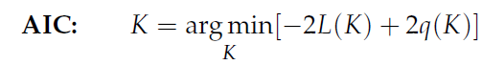
Choosing clustering dimension
AIC or Akaike Information Criterion:
AIC信息准则即Akaike information criterion，是衡量统计模型拟合优良性的一种标准，由于它为日本统计学家赤池弘次创立和发展的，因此又称赤池信息量准则，它建立在熵的概念基础上，可以权衡所估计模型的复杂度和此模型拟合数据的优良性。
K=dimension, L(K) is the likelihood (could be RSS) and q(K) is a measure of model complexity (cluster description complexity).
AIC favors more compact (fewer clusters) clusterings.
For sparse data, AIC will incorporate the number of non-zeros in the cluster spec. Lower is better.

Slide 38
Outline for this Evening
Three Basic Algorithms
kNN
Linear Regression
K-Means
Training Issues
Measuring model quality
Over-fitting
Cross-validation

Slide 39
Model Quality
Almost every model optimizes some quality criterion:
For linear regression it was the Residual Sum-of-Squares
For k-Means it is the “Inertia” – the mean squared distance from each sample to its cluster center.
…
The quality criterion is chosen often because of its good properties:
Convexity: so that there is a unique, best solution
Closed form for the optimum (linear regression) or at least for the gradient (for SGD).
An algorithm that provably converges.

Slide 40
Model Quality
There are typically other criteria used to measure the quality of models. e.g. for clustering models:
Silhouette score
Inter-cluster similarity (e.g. mutual information)
Intra-cluster entropy
For regression models:
Stability of the model (sensitivity to small changes)
Compactness (sparseness or many zero coefficients)
Notes:
Silhouette score
轮廓
用聚类算法分好类后如何判断分的效果呢？方法就是轮廓系数(Silhouette)。
Silhouette系数是对聚类结果有效性的解释和验证，由Peter J. Rousseeuw于1986提出。
方法： 1，计算样本i到同簇其他样本的平均距离ai。ai 越小，说明样本i越应该被聚类到该簇。将ai 称为样本i的簇内不相似度。 簇C中所有样本的a i 均值称为簇C的簇不相似度。 2，计算样本i到其他某簇Cj 的所有样本的平均距离bij，称为样本i与簇Cj 的不相似度。定义为样本i的簇间不相似度：bi =min{bi1, bi2, ..., bik} bi越大，说明样本i越不属于其他簇。 3，根据样本i的簇内不相似度a i 和簇间不相似度b i ，定义样本i的轮廓系数： 4，判断： si接近1，则说明样本i聚类合理； si接近-1，则说明样本i更应该分类到另外的簇； 若si 近似为0，则说明样本i在两个簇的边界上。 所有样本的s i 的均值称为聚类结果的轮廓系数，是该聚类是否合理、有效的度量。

Slide 41
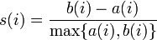
Evaluating Clusterings: Silhouette
The silhouette score is
where a(i) is the mean distance from sample i to its own cluster,
b(i) the mean distance from i to the second-closest cluster.
Perhaps surprisingly, silhouette scores can be, and often are, negative.

Slide 42
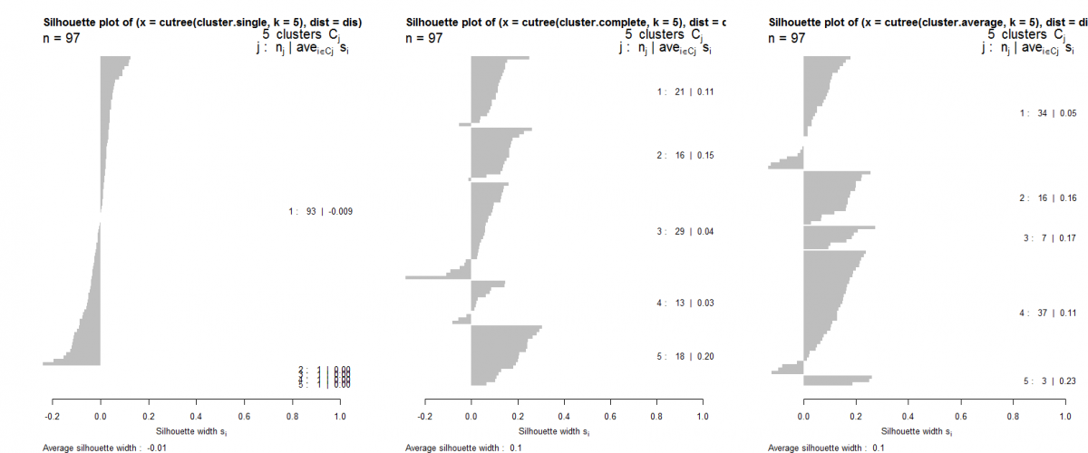
Evaluating Clusterings: Silhouette
Silhouette plot: horizontal bars with cluster score.
Sort (vertically) first by cluster, then by score.

Slide 43
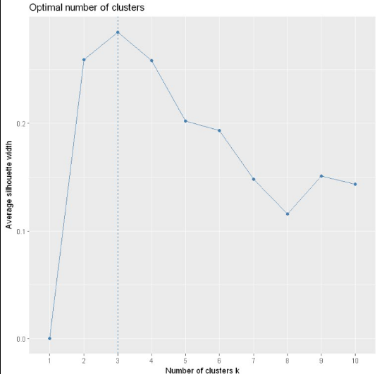
可以看到也是在聚类数为3时轮廓系数达到了峰值，所以最佳聚类数为3

Slide 44
Regularization with Secondary Criteria
While secondary criteria can be measured after the model is built, its too late then to affect the model.
Using secondary criteria during the optimization process is called “regularization”.
Examples:
L1 regularization adds a term to the measure being optimized which is the sum of absolute value of model coefficients.
L2 regularization adds a term to the measure being optimized which is the sum of squares of model coefficients.

Slide 45
Regularization with Secondary Criteria
L1 regularization in particular is very widely used. It has the following impacts:
Yields a convex optimization problem in many cases, so there is a unique solution.
The solution is usually stable to small input changes.
The solution is quite sparse (many zero coefficients) and requires less disk and memory to run.
L1 regularization on factorization models tends to decrease the correlation between model factors.

Slide 46
Over-fitting
Your model should ideally fit an infinite sample of the type of data you’re interested in.
In reality, you only have a finite set to train on. A good model for this subset is a good model for the infinite set, up to a point.
Beyond that point, the model quality (measured on new data) starts to decrease.
Beyond that point, the model is over-fitting the data.

Slide 47
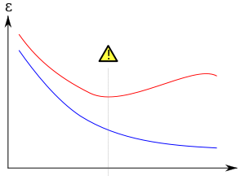
Over-fitting
Over-fitting during training
Model error
Error on new data
Training error
Number of iterations

Slide 48
Over-fitting
Another kind of over-fitting
Model error
Error on new data
Training error
Model degrees of freedom

Slide 49
Regularization and Over-fitting
Adding a regularizer:
Model error
Without regularizer
With regularizer
Number of iterations

Slide 50
Cross-Validation
Cross-validation involves partitioning your data into distinct training and test subsets.
The test set should never be used to train the model.
The test set is then used to evaluate the model after training.

Slide 51
K-fold Cross-Validation
To get more accurate estimates of performance you can do this k times.
Break the data into k equal-sized subsets A_{i}
For each i in 1,…,k do:
Train a model on all the other folds A₁,…, A_{i-1}, A_{i+1},…, A_{k}
Test the model on A_{i}
Compute the average performance of the k runs

Slide 52
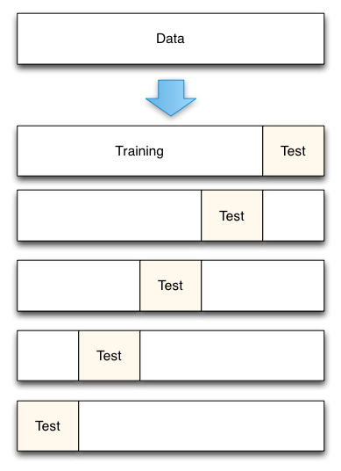
5-fold Cross-Validation

Slide 53
Summary
Three Basic Algorithms
kNN
Linear Regression
K-Means
Training Issues
Measuring model quality
Over-fitting
Cross-validation

